Slide 1
Proof of Value Fast Invoicing

Slide 2

Agenda
Overview of existing invoicing system
Using Blockchain in invoicing systems
Capgemini Prototype: Fast Invoicing
Capgemini’s Value Proposition

Slide 3
Overview of invoicing systems
Many organizations employ multiple third-party tools (BMC,SAP etc.) for invoice management and generation when different branches interact between each other after providing services – This is highly inefficient and also costs a lot.
Supporting Participants
SR Processor/ Agent
Core Participants
Service receiver (SR)
SP Processor/ Agent
Invoicing systems
Service provider (SP)
Tax approver
Third-party Invoice management/ generation organizations

Slide 4





Invoicing systems Current-state process
2
Invoice request raised and sent for approval
SP
SR
SR
SP
SR
1
3
5
7
Service requested
Sent for Tax approval
Query handling
Exception handling and closing
SP – Service Provider
SR – Service Recipient
4
Request assigned to SP agent
6
Request assigned to SR agent
Third party workflow management system
Tax approver
SP agent
SR agent
Third party ERP system
SR
2
After service has been requested, invoice request raised on a third party workflow tool like BMC and forwarded for approval from counterparty/SR if required
6
On query resolution, SP agent routes the request to the processing queue of the SR’s third party ERP system (like SAP) after transferring the invoice documents to the BMC tool from the SP SAP system
4
Specific agent notified of request assignment to him/her
7
SR agent handles exceptions as per guidelines, processes the request and then closes the request in BMC with the help of SAP number
5
In case of query by the SR, the SP agent routes the request to query queue in BMC until the response from SP. Emails get exchanged to find resolutions to the queries

Slide 5

Invoicing systems Current-state pain points
2
Invoice request raised and sent for approval
SP
SR
SR
SP
SR
1
3
5
7
Service requested
Sent for Tax approval
Query handling
Exception handling and closing
4
Request assigned to SP agent
6
Request assigned to SR agent
SP – Service Provider
SR – Service Recipient
Tax approver
SP agent
Third party workflow management system (BMC)
SR
SR agent
A
B
Third party ERP system (SAP)
A
The SP agent has to manually:
Handle all queries in consultation with SR
Download request details from BMC
Upload request details to SAP instance of SP
Download invoice docs from SAP instance of SP
Upload the invoice docs into BMC
Route the request to the SR agent
B
The SR agent has to manually:
Handle all exceptions
Download request details from BMC
Upload request details to SAP instance of SR
Download invoice docs from SAP instance of SR
Upload the invoice docs into BMC
Utilize the SAP doc number and close the request in BMC
Both agents have to use both tools multiple times to complete a very complex, time-consuming and inefficient process

Slide 6




Using Blockchain for invoicing systems Benefits
Invoicing systems
1
SR agent
Shared truth
(On a need to know basis)
SP Agent
2
Distributed ledger
Data integrity
(Immutability, traceability, auditability)
Service Recipient
3
Smart Contract
Process Automation
(Smart contract)
Service Provider
Tax regulator
Third party tools
4
Unified platform
Efficient processes
Automated workflow management
DL database
Local database
Note: There can be as many actors/nodes as needed in the network

Slide 7

Fast Invoicing Scope
1
On invoicing system- to remove the clutter of multiple tools
2
Creates a shared ledger for all agents to be more efficient
3
Specific to the workflow of the client’s invoicing process

Slide 8
Fast Invoicing Prototype Flow
2
Invoice request raised and sent for approval
SP
SR
SR
SP
1
3
5
7
Service requested
Sent for Tax approval
Query handling
Exception handling
6
8
Blockchain ecosystem
4
Request assigned to SP agent
All interactions with SAP
SP – Service Provider
SR – Service Recipient
SR
Tax approver
SP agent
SR agent
Third party ERP system
2
Smart contracts that validate details in the invoice request and enforces SLA execution automates processes earlier done through BMC
4
3
Every approval changes the state of the request and this is automatically updated in blockchain without manual intervention. Routing of request to various SAP instances and agents in the system are also done automatically
8
6
Posting request to SAP, downloading the invoice from SAP and uploading it back to blockchain are all automated, thereby saving time and effort. Request closing and notification also no longer requires manual work

Slide 9
Fast Invoicing Features of the Solution
TBU
1
Automation of interactions with SAP for agents
2
Smart contracts to do validation and SLA enforcement
3
Workflow management completely automated using blockchain platform

Slide 10




Fast Invoicing Benefits of the Solution
Reduced Operational Cost
Increased Transparency
Third party workflow management tools are no longer required as blockchain replaces it completely
Transparency is enhanced through uni-platform experience for all stakeholders
Shared ledger
The platform, and hence the ledger which records all transactions, is shared among all agents and stakeholders
Enhanced Efficiency
Time and effort saved as agents become more efficient as they have to interact with only one platform that takes care of everything for them
Highly Customizable
The POC is highly scalable to include any further functionalities including more geographies and stakeholders
Notes:
Improve Process Efficiency due to shared ledger as silos are removed
Automation of Process thus improving co-ordination and communication
Future scope using blockchain: better connection. corresponding banking no need; de-centralized – possibly remove parties such as, SWIFT

Slide 11
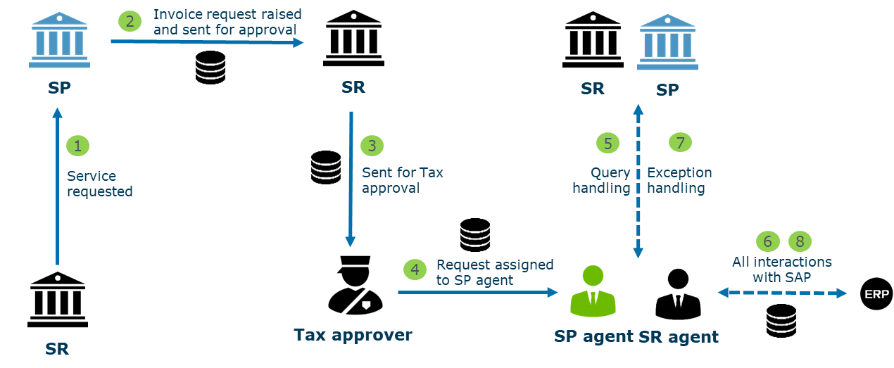

Fast Invoicing Prototype Developed on Hyperledger Fabric
Developed on Hyperledger Fabric
Fabric

Slide 12

Fast Invoicing Functional Architecture of the Solution
SP agent
SR agent
SR
SP
Tax approver
Application
Fast Invoicing User Interface
UI
UX
1
2
3
4
5
User Mgmt. Services
Service Request Mgmt.
Master Data Services
Push/Pull SAP Services
Reporting Services
Interfaces
Business API Layer
Infrastructure Services
SR/SP SAP Instances
Message Transformation
Audit / logging
Listeners/ Notifiers
Error handlers
Blockchain services
Chaincode Services
Blockchain / Transaction Services
Membership Services
Secure container
Consensus
P2P protocol
Registration
Identity Management
Blockchain
Secure registry
Ledger / Storage services
Auditability
Event streaming
Blockchain Network/Shared ledger
Notes:
API Layer: HTTP; open and interoperable.
The features mentioned can be designed based on the requirement of the project
Infrastructure services and Blockchain services:
The components have been mentioned but the actual content will need to be decided based on the project .e.g. what Consensus protocol to use
Infrastructure components are standard components and they can be modified based on requirement
Blockchain services are the services that Hyperledger Fabric provides
Message Transform: connecting messaging that are in different languages
Audit/logging: Checking information received
Listener/Notification: Checks the updates

Slide 13









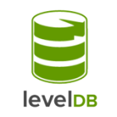


Fast Invoicing Technology Stack of the Solution
SP agent
SR agent
SR
SP
Tax approver
Application
Fast Invoicing User Interface
UI
UX
Business API Layer
1
2
3
4
5
User Mgmt. Services
Service Request Mgmt.
Master Data Services
Push/Pull SAP Services
Reporting Services
Interfaces
Infrastructure Services
SR/SP SAP Instances
Message Transformation
Audit / logging
Listeners/ Notifiers
Error handlers
Blockchain services
Chaincode Services
Blockchain / Transaction Services
Membership Services
Secure container
Consensus
P2P protocol
Registration
Identity Management
Blockchain
Secure registry
Ledger / Storage services
Auditability
Cloud services
Event streaming
Smart Contract
Deployment
Notes:
Smart Contract technology stack: Java; Golang programming language (Hyperledger)
Cloud services also includes AWS

Slide 14
Capgemini’s Value Proposition Proof of Value : A 2 to 3 month process
4-6 weeks
4-6 weeks
1 week
1 day
A
Solution
Design
B
Development
C
Presentation
and Report
D
General
Audience
presentation
Focus on solution design supporting a business need
High intensity interaction with client
Build the proof of concept
Low intensity interaction with clients
Present the demo (dry run) and report to working
Fine tune report and presentation
Demonstration of the PoC to all the stakeholders

Slide 15

Capgemini’s Value Proposition Example of a Joint Client/Capgemini Team on a Typical Blockchain Agile Project
Engagement Exec
Client Team
E2E Solution Owner Engagement Manager
Scrum Master
Program Manager
Product Owner/Senior BA
Tester
1 Blockchain Dev
2 Blockchain Dev
Teams
Client
Senior BA
3 Blockchain Dev
4 Blockchain Dev
Solution Design Lead
ADVISORY
Blockchain Lead
Domain Expert
Data Protection
FinTech Lead
Other business partners (compliance, risk, legal)
Capgemini commits continuous delivery in agile method through:
Ensuring resources availability
Managing roll-in, roll-out, and competency recovery
Set-up and maintain Agile methodology
*Engagement Exec is accountable for the proper overall application delivery agreed on the contract
*Engagement Manager is accountable of the operational delivery for Capgemini Teams

Slide 16








Capgemini’s Value Proposition Set-Up on Blockchain
Core Team with global footprint
Rightshore Delivery Model
Technical Experts
Architect
ONSHORE
Cloud
Data & Cybersecurity
Developer Team
NEARSHORE
Tech Lead
Core Developers & Solutions Architects:
→ Onshore [20+]
→ Offshore [30+]
OFFSHORE
India
Domain Experts
Structured Finance
Payments & Cash mgt.
Capital Markets
Insurance
Digital identity

Slide 17
Appendix 1
Comparison Hyperledger Fabric vs R3/Corda

Slide 18
Platform Comparison Fabric vs Corda
Fabric
Corda
General purpose blockchain
Platform
Distributed ledger technology (DLT) for financial markets
Private, consortium managed, pluggable identity stores
Membership
Private, network managed
All party consensus at Individual transaction level, pluggable (PBFT, Raft, PoW, PoS)
Consensus
Consensus by parties involved in transaction. Notary services using pluggable algorithm Raft
Permissioned, endorsement policies, channels for privacy
Permissions/ Privacy
Permissions with doorman services, data masks in transactions for privacy
Transaction replication on all node ledgers
Ledger replication
Transaction replication on specific node involved in transaction
Supported with oracle services for external integration
Smart contracts
Supported with oracle services for external integration
Not supported
Mining
Not supported
Not supported
Crypto-Currencies
Not supported

Slide 19
Platform Comparison Fabric vs Corda
Fabric
Corda
High platform development maturity for production
High scalability
More precise model for the multiparty agreements with financial industry
More open for external interaction
More modular; easing identity management and consensus
Lower storage needs
High community support
Good community support
Smart Trade Chain has been developed using both platforms

Slide 20
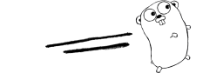




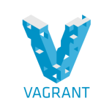




Technology Stack Fabric vs Corda
Hyperledger - Fabric 1.0
User Interface | API | Blockchain Network | Smart Contract | Deployment
R3-Corda 0.14
UI/ CordApp | Blockchain Network | Smart Contract | Build/ Deployment
Node Communication: Peer-Peer Broadcast, HTTP2/gRPC
Node Communication: Point-to-point, AMQP1.0

Slide 21
Smart Trade Chain Data Model of Prototype
Seller
Seller’s Bank
Buyer
Buyer’s Bank
Transporter
Insurer
Sales Contract
Product Details
Delivery Details
Insurance Details
REFERS
UPDATE
SHARED LEDGER
Configurations
Trade Conditions
LC Regulations
Payment Conditions
SLAs
USES
VALIDATE

Slide 22
Appendix 2
Deep dive on Hyperledger Fabric

Slide 23
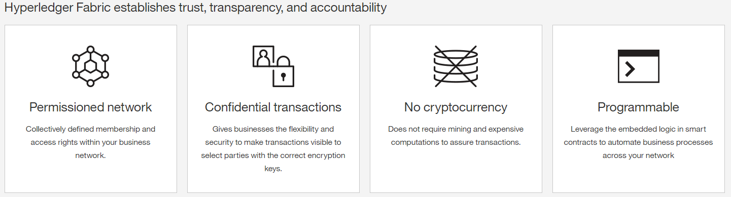
Hyperledger Fabric 1.0 Blockchain
Hyperledger is an open source collaborative effort created to advance cross-industry blockchain technologies. It is a global collaboration, hosted by The Linux Foundation, including leaders in finance, banking, Internet of Things, supply chains, manufacturing and technology.
Fabric Features
Modular architecture supporting plug-in components including identity management, consensus, and encryption standards
Data on need to know basis, data partitioning on blockchain network with channels
Rich queries over shared ledger, JSON format supports advanced query options on ledger
Rich toolset for development support e.g. Fabric, Composer, Explorer

Slide 24
Hyperledger Fabric 1.0 Blockchain
Characteristics
Consensus | All party consensus at Individual transaction level, pluggable features include consensus using algorithms, such as, byzantine fault tolerance algorithm (PBFT), Raft, proof of work (PoW), proof of stake (PoS)
Membership Service Provider | Identity membership provider to manage members and permissions, separate membership and transaction certificates to members for security. Pluggable identity sources like LDAP
Smart Contracts | Executes programs on all the nodes governing the transaction validation and business transactions
Privacy/Confidentiality | Permissioned nodes with secured transactions, data privacy and confidentiality with network channels / sub networks
External Integration | Supported with oracle services and smart contracts calling external services
Focus
Finance | Streamlined settlement, improved liquidity. Provide increased transparency and new products/markets
Health-care | Unite disparate processes, increase data flow and liquidity. Reduce costs and improve patient experience and outcomes
Supply Chain | Track parts and service provenance, ensure authenticity of goods, block counterfeits. Reduce conflicts
Notes:
The Lightweight Directory Access Protocol is an open, vendor-neutral, industry standard application protocol for accessing and maintaining distributed directory information services over an Internet Protocol (IP) network

Slide 25
Hyperledger Fabric Capabilities
Identity management
Chaincode functionality
To enable permissioned networks, Hyperledger Fabric provides a membership identity service that manages user IDs and authenticates all participants on the network
Chaincode applications encode logic that is invoked by specific types of transactions on the channel
Privacy and confidentiality
Modular design
Private channels are restricted messaging paths that can be used to provide transaction privacy and confidentiality for specific subsets of network members
Hyperledger Fabric implements a modular architecture to provide functional choice to network designers
Specific algorithms for identity, ordering (consensus) and encryption, for example, can be plugged in to any Hyperledger Fabric network
Efficient processing
Hyperledger Fabric assigns network roles by node type
To provide concurrency and parallelism to the network, transaction execution is separated from transaction ordering and commitment.

Slide 26
Hyperledger Fabric 1.0 Blockchain
Network
The blockchain is a distributed system consisting of many nodes that communicate with each other
The blockchain runs programs called chaincode, holds state and ledger data, and executes transactions.
Orderer
Chaincode is a program usually written in Go. A chaincode typically handles business logic agreed to by members of the network, so it may be considered as a “smart contract”.
SOLO
KAFKA
PBFT
There are three types of nodes:
Client or submitting-client: a client that submits an actual transaction-invocation to the endorsers
Peer: a node that commits transactions
Ordering-service-node or orderer: a node running the communication service that implements a delivery guarantee
Organization 1
Organization 2
Network with members organization 1,2, and 3 is shown
Private channels can be created for specific subsets of network members
Figure shows channel which has organization 1 and organization 2
Channel 1
Organization 3
Notes:
Network depiction shows a Channel that comprises of 2 nodes (Organization 1 and organization 2). A channel will have an orderer. The role of the orderer is to order the transactions on the channel coming from multiple nodes, and validate double-spend
The Box shows a blow up diagram of a node (Organization 1). The node comprises of MSP (Membership service provider) and PEER.
MSP:
Provides pluggable identity stores (e.g. LDAP). For managing and verifying identities within an organization, the Intermediate certificate Authority is responsible.
The intermediaries belong to the same RCA. This RCA connects to intermediate certificate authority. This RCA is useful for identities outside the organization
PEER:
The endorser (endorsing services) will endorse transaction and simulate transaction to check validity of transaction
Endorsed transactions are broadcasted to the channel. And the orderer orders the transaction and relays the information back to the Endorser and Committer
Once a transaction reaches the committer, it is then added to the ledger/blockchain

Slide 27


Hyperledger Fabric 1.0 Blockchain
Network
Root Certificate Authority
Organization 1
MSP
Intermediate Certificate Authority
1
Identity Store
Channel
MySQL
PgSQL
LDAP
Enrollment CA
Transaction CA
TLS
CA
2
PEER
3
Endorser
Enrollment Certificate
Transaction Certificate
TLS Certificate
Organization 2
Committer
4
ChainCode/Smart Contract
Events
6
Orderer
7
World State/LEDGER
SOLO
KAFKA
PBFT
5
Image above shows the transaction flow in a channel
1.Enroll user (via Membership service providers)
2. e-Certificate generated for user
3. Endorse transaction
4.Simulate transaction
5. Relay submit transaction
6.Deliver batch/ block
7.Commit block to ledger
Notes:
Network depiction shows a Channel that comprises of 2 nodes (Organization 1 and organization 2). A channel will have an orderer. The role of the orderer is to order the transactions on the channel coming from multiple nodes, and validate double-spend
The Box shows a blow up diagram of a node (Organization 1). The node comprises of MSP (Membership service provider) and PEER.
MSP:
Provides pluggable identity stores (e.g. LDAP). For managing and verifying identities within an organization, the Intermediate certificate Authority is responsible.
The intermediaries belong to the same RCA. This RCA connects to intermediate certificate authority. This RCA is useful for identities outside the organization
PEER:
The endorser (endorsing services) will endorse transaction and simulate transaction to check validity of transaction
Endorsed transactions are broadcasted to the channel. And the orderer orders the transaction and relays the information back to the Endorser and Committer
Once a transaction reaches the committer, it is then added to the ledger/blockchain

Slide 28
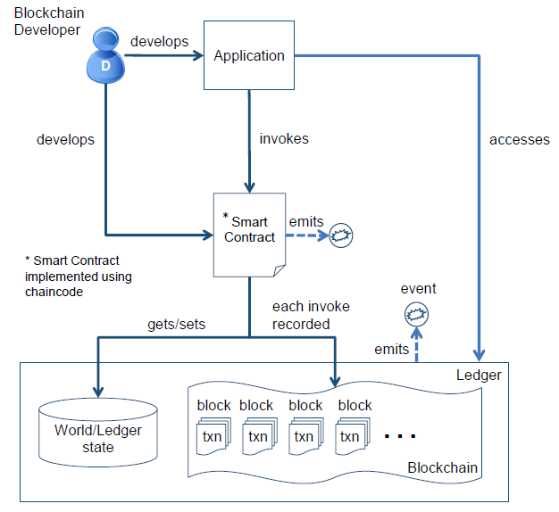

Hyperledger Fabric Application Flow
Blockchain User
Peer

Slide 29
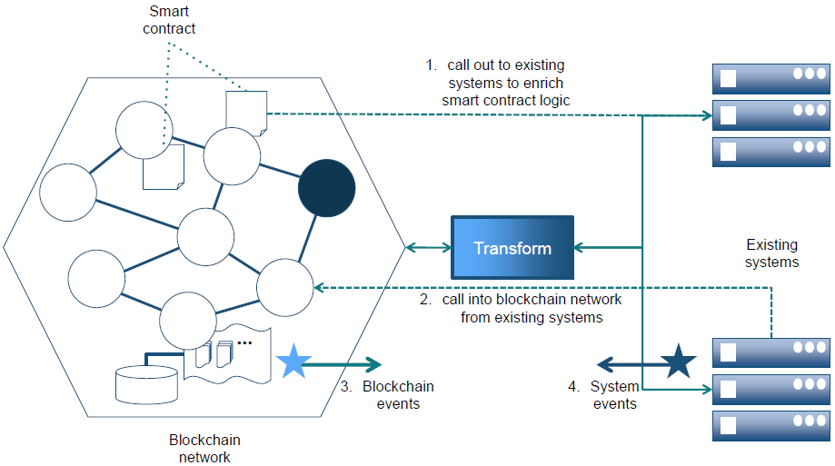
Fabric Integration with Existing Systems
Notes:
Fabric allow interaction with existing systems. Can be part of smart contract (but must be deterministic)
1&2 are implicit interaction between smart contract and existing systems
3&4 are explicit interaction between smart contract and existing systems

Slide 30
Appendix 3
Credentials

Slide 31
Capgemini’s Value Proposition Focus on Financial Services and Delivery
Structured Finance
Payments
Capital Markets
Insurance
Digital Identity
Trade Finance
Trade Commodity Finance
Factoring
Cross-border payments
Cash mgt.
PSD2
“Cash on the ledger”
Non-listed securities
Syndication
Securitization
Insurer/Broker platforms
Digital asset tracking (Car&Homes)
Reinsurance
KYC – Digital Identity in CIB
Digital Identity in retail (individuals)
Advisory
POV
Permission
Prototype
Production
Operations

Slide 32






Capgemini’s Value Proposition Product and Solution Footprint
11+
8
Live Projects
Banking
Insurance
Trade Finance
Digital Identity
POCs
6 scoping + 2 live
1
6
Published whitepapers
Digital Identity Solution
Development Platforms
Experience
Fabric
Corda
Ethereum
BigchainDB
Bitcoin

Slide 33
Blockchain Credentials Last IBM Hyperledger Blockchain Hackathon – A dedicated Training process
3000 Hours of Training and Hands-on lab sessions delivered on niche emerging skills
+1000
Training Workshops
5-Days comprehensive hands-on training on Hyperledger provided by ADM Training and IBM team to all participants
1200 Participants across ADM and other practices up-skilled during Hackathon week
100 Finalists (10 Architects, 20 UI Developers & 70 Developers) across 20 teams selected for Hackathon Finale through Technical Assessments
Level 1 – Technical Assessment
Technical competency assessment of all participants. Successful participants qualify for Hackathon Finale
+100
4 solutions - Blockchain published
Level 2 – Hackathon Code Challenge
Code challenges with 3 business scenarios in to solve in 1.5 Days
+15
7+ proposals

Slide 34
Blockchain Credentials Portfolio of Proof of Concepts
Count of POCs | DOMAIN | TOPIC | Description | Development Team | Hyperledger | CORDA | Ethereum | BigchainDB | Bitcoin
 |  |  |  |  | FABRIC
1 | PAYMENTS | LOYALTY | Digital Loyalty Tokens Platform that enables multi-tenant, cross-platform collaboration and a de-centralized exchange for easy and quick conversion of Loyalty tokens | CoE Pune |  |  |  | ü
2 |  | PSD2 Compliance | Blockchain solution for Payment Service Directory 2 (PSD2) targets to create a common framework and standard for Third Parties and Financial Institutions to authorize transactions between 2 parties | Benelux |  |  | ü
3 | KYC | Know Your Customer | Using blockchain the customers KYC details will be shared across all banks / intra-bank departments and every banks / intra-bank department will have same master copy of KYC data as others. This solution is developed in both Hyperledger Fabric and R3 Corda | CoE Pune | ü | ü
4 | TRADE FINANCE | Trade Finance | This solution automates the still manual trade finance process by transforming letters of credit to smart contracts with automated payments, digitizing printed documents as metadata, and creating a record of ownership in each step such as bills of landing and storing them | CoE Pune | ü | ü
5 |  | Trade Finance | A block chain-based Trade Finance Solution allows all the parties in the Trade Finance Value Chain ( Importer, Importers Bank, Exporter, Exporters Bank, Customs Office, Port Authorities, Shipping Companies ) to access the Trade Documents using a single platform and also enables faster processing of the transaction | Bangalore | ü | ü
6 | SUPPLY CHAIN MANAGEMENT | Supply Chain Management | Supply Chain Management Corda (Project with industry company) | Benelux |  | ü
7 |  | Smart Logistics | Smart logistics Bitcoin (POC internal) | Benelux |  |  |  |  | ü
8 | BANKING | Private Securities | Private Securities Blockchain solution enables Capital Markets firms to create Digital Assets for Private Securities and automates the Master Order Book, Corporate Action and Exchange of Digital Securities, with the direct and immediate access and oversight of State Regulatory Bodies | Bangalore |  |  | ü
9 |  | Syndicated Lending | A de-centralized solution that brings a common digital platform to a small group of stakeholders (Lead Bank, Participating Bank and Borrower) to increase efficiency (conversion from paper to digital) | Bangalore |  |  | ü
10 |  | Core banking | Core Banking Ethereum (Project with large international bank) | Benelux |  |  | ü
11 | INSURANCE | Insurance | Insurer/broker platform Corda (Project with consortium) | Benelux |  | ü
12 |  | P2P Insurance | P2P insurance Bitcoin (client project with insurer) | Benelux |  |  |  |  | ü
13 | OTHERS | Conflict-zone communication system | White Flag 0.1 Application is the first version of a conflict-zone communication system proof of concept. This is the first version, in which the “Military Coalition” can send information about military operations to the network, or the “Aid Organization” can send information about humanitarian operations to the network. | Benelux |  |  |  |  | ü

Slide 35
Blockchain Credentials Our Blockchain Development Skills
Languages
Java
Node JS
Go-Lang
Python
Kotlin
C++
Solidity
Serpent
Modeling Languages
Blockchain
Security
Cryptography
Database architecture
Peer to Peer Messaging
Consensus algorithm
Smart Contract
Distributed Ledger
Environments
NO SQL DBs
Docker Container
Swarm/ Kubernetis
VMWare
AWS
IBM Bluemix
Azure/COCO
Tools
Hyperledger
Composer
Explorer
Playground
R3-Corda
Node Explorer
DemoBench
Etherium-
Truffle
Embark
Dapple
Javascript testrpc
ReMix
Protocols
Gossip
gRPC
RPC
AMQP
HTTP/S
Frameworks
Angular JS
Node JS
Ext JS
Meteor
ReactJS
Bootstrap
Spring/ Spring Boot
Web APIs
Platforms
Hyperledger Fabric 1.0
R3-Corda
BigchainDB
Ripple
Etherium

Slide 36
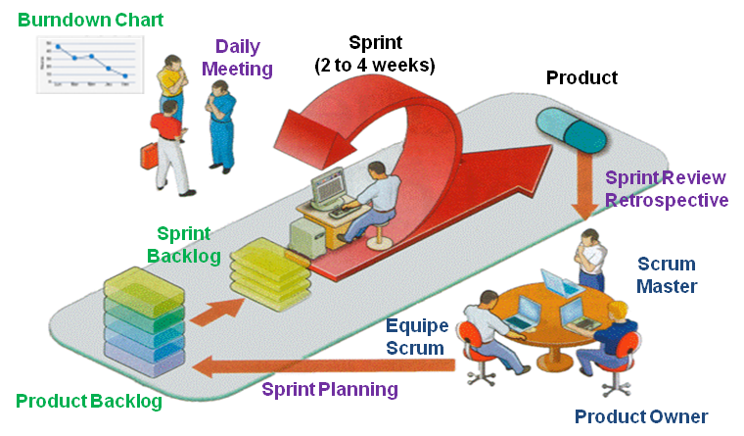
Capgemini’s Agile Methodology Why Agile?
The key benefits of agile approaches
Control delays implementation
Prioritize their value added functions
Rapid access to essential functions
Delete the tunneling / incremental results
Maximize business value by prioritizing functions in a project runs in incremental mode
Overview of the Agile approach
An agile approach with
Flexibility, implementation and monitoring of a "backlog" prioritizing functions and services to be implemented
Collaborative build with all stakeholders, MOA, MOE and Production

Slide 37


Capgemini’s Agile Methodology Scrum Overview
Offering
Roles
Scrum Master
Product Owner
Development Team
Events
Sprint Planning
Daily Scrum
Sprint Review
Sprint Retrospective
Artifacts
Product Backlog
Sprint Backlog
Increment
Burndown Chart
The core principles
Shared Visual workspace
Removing physical barriers
Transparency & Visual Management
Face-to-face Communication
Self-organization
Empowered cross-functional Teams
Incremental design and architecture
Inspection and adaptation
Empiricism
Continuous Improvement
Knowledge from experience
Detect & eliminate variances

Slide 38
Capgemini’s Agile Methodology MVP Approach
MVP approach in short
MVP approach inputs to the Project
MVP is all about
Incremental building by
Defining some key assumptions
Validating or invalidating these assumptions
Persevere or Pivot
Making key assumptions
Gut feeling
Studies / Surveys
Workshops with user
...
Validating or invalidating assumptions
Wireframes and mockups
User testing group
Prototype
Pivoting if the hypothesis proves to be wrong … Then making new assumptions and starting over
Assess possibility to go with small and regular releases vs. big bang release
Obtain real users feedbacks
Avoid persevering on a wrong path
Adopt an agile methodology
No full detailed specifications upfront
Open to change
Improve time to market
Minimum Viable Product first
Maximum value for users first
Iterate on a viable product as soon as possible
Ideas
LEARN
BUILD
Data
Product
MEASURE

Slide 39
Capgemini’s value proposition Methodology – Anatomy of a Sprint
Sprint (2 weeks)
2
Daily Meeting (15 mn)
Objective: Deliver a working product ready for going live
Activities: Design, development, testing, documentation …
Participants: Development team
3
Objective: Share daily the progress of the Sprint
Participants: development team + Product owner
2
3
Sprint Review (2 h)
4
1
Objective: Development team show what has been delivered in the Sprint
Participants: Product Owner + Development team + diverse business users
Team
Sprint Planning (4 h)
1
Scrum Master
Product Owner
Objective: Define the content of the Sprint depending of the business value and the velocity
Participants: Product Owner + development team + Agile Coach
Sprint Retrospective (2 h)
6
5
Delivery of a new version of the product
Objective: Feedback on the process, point out the possible improvements, build an action plan to improve
Participants: Product Owner + development team + Agile Coach
5
4

Slide 40
Appendix 4
Fast Invoicing Prototype - Screenshots

Slide 41

Fast Invoicing Screenshots: Flow of prototype
Login page

Slide 42
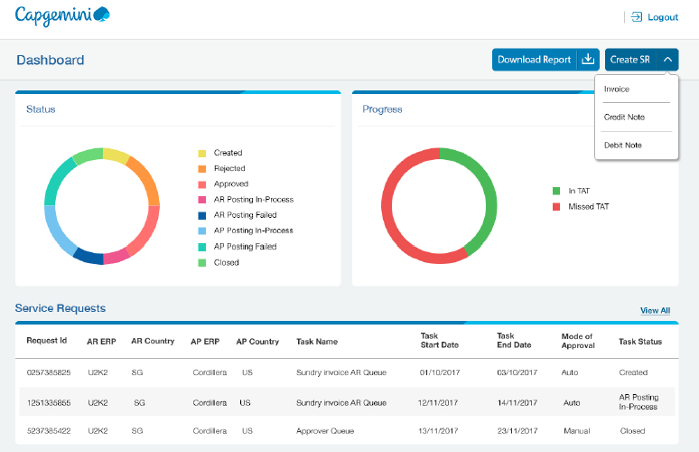
Fast Invoicing Screenshots: Flow of prototype
Dashboard

Slide 43
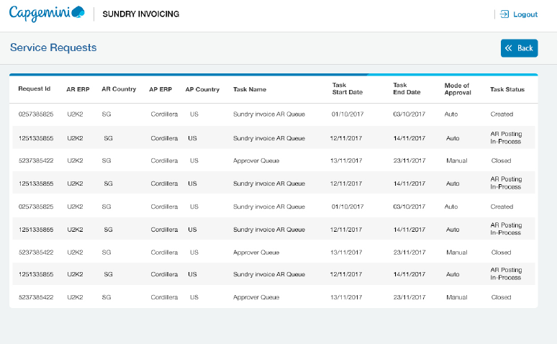
Fast Invoicing Screenshots: Flow of prototype
List of requests

Slide 44
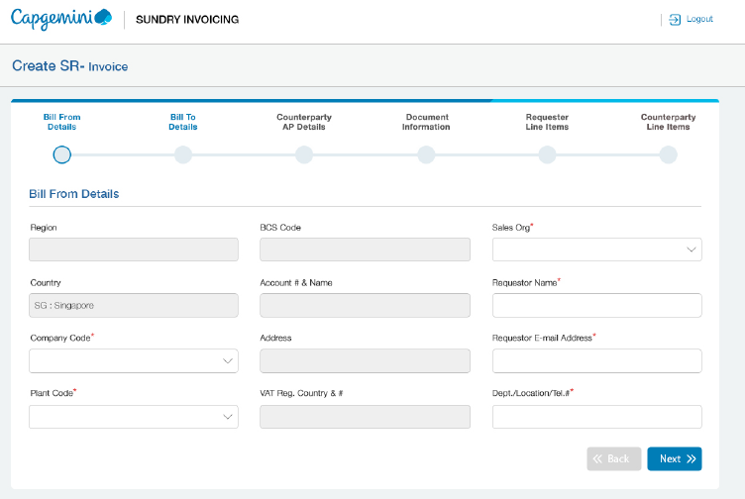
Fast Invoicing Screenshots: Flow of prototype
Raising invoice request

Slide 45
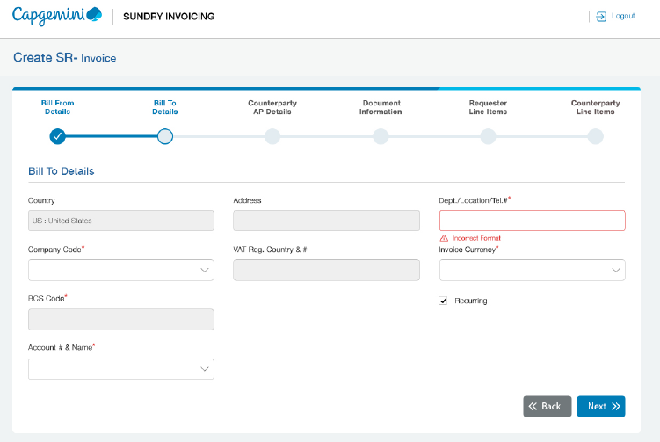
Fast Invoicing Screenshots: Flow of prototype
Raising invoice request

Slide 46
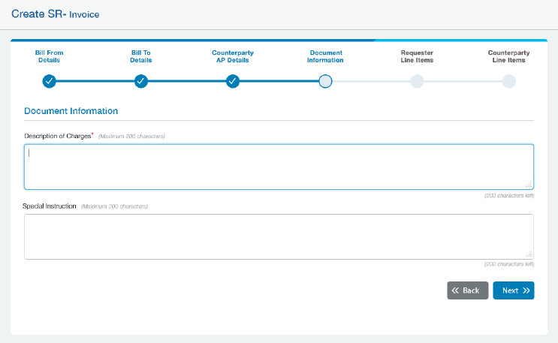
Fast Invoicing Screenshots: Flow of prototype
Raising invoice request

Slide 47
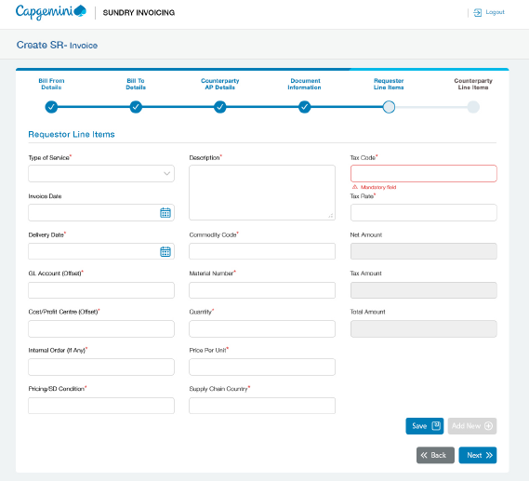
Fast Invoicing Screenshots: Flow of prototype
Raising invoice request

Slide 48
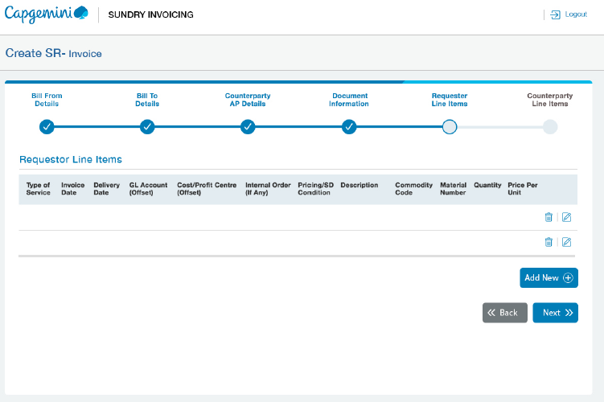
Fast Invoicing Screenshots: Flow of prototype
Raising invoice request

Slide 49
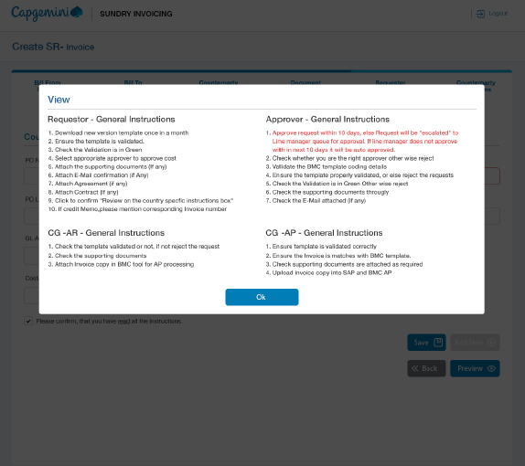
Fast Invoicing Screenshots: Flow of prototype
Raising invoice request

Slide 50
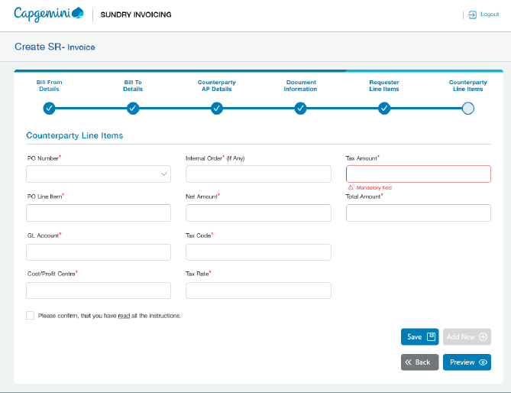
Fast Invoicing Screenshots: Flow of prototype
Raising invoice request

Slide 51
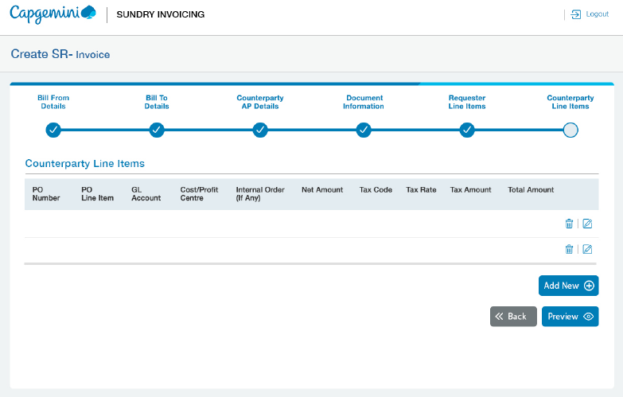
Fast Invoicing Screenshots: Flow of prototype
Raising invoice request

Slide 52
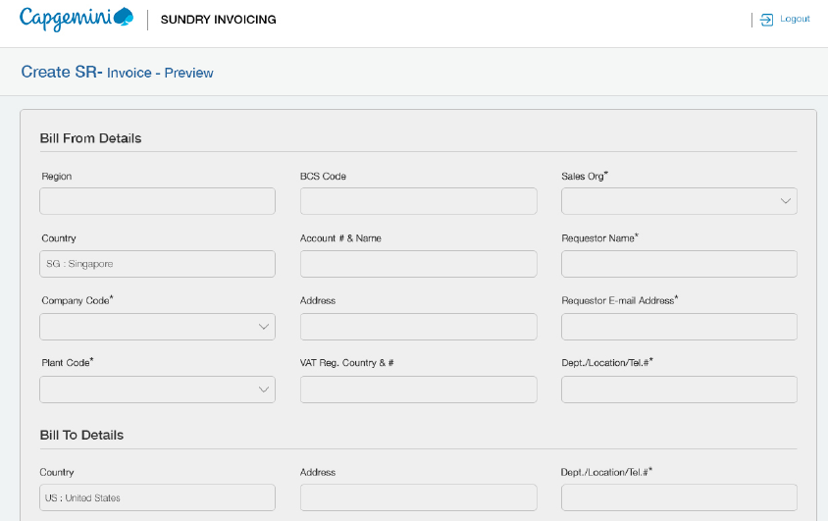
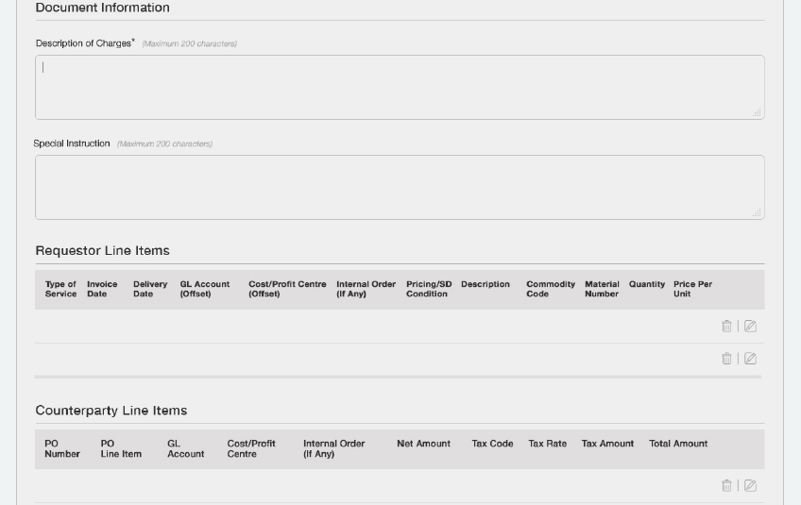
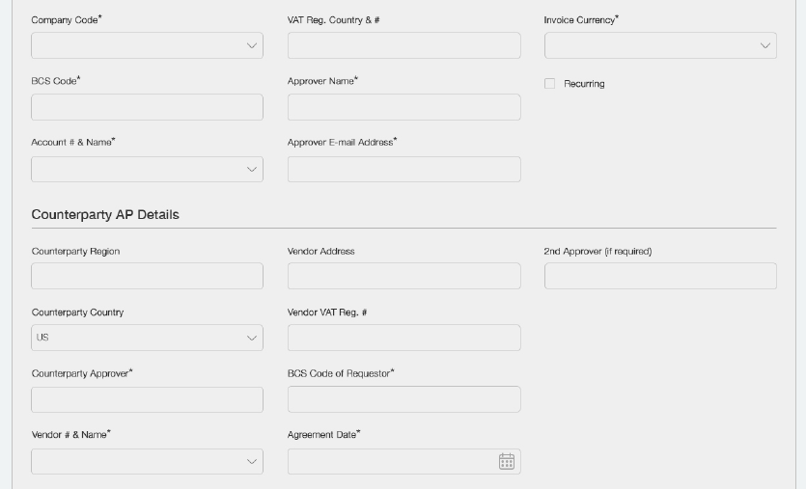
Fast Invoicing Screenshots: Flow of prototype
Raising invoice request

Slide 53
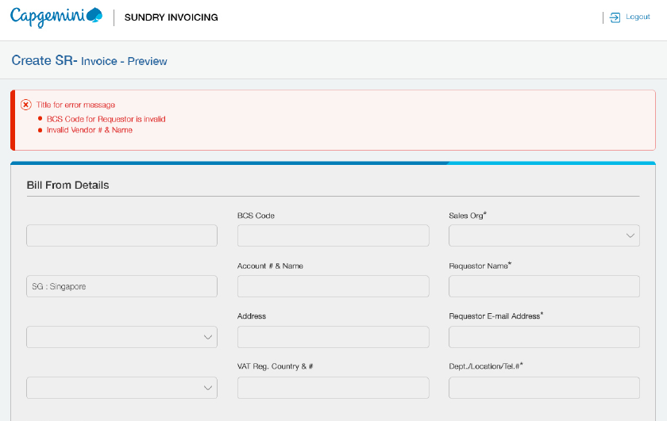
Fast Invoicing Screenshots: Flow of prototype
Raising invoice request

Slide 54
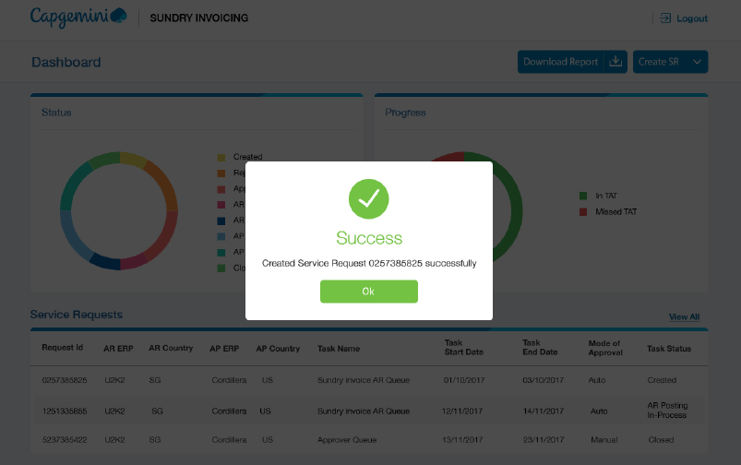
Fast Invoicing Screenshots: Flow of prototype
Raising invoice request

Slide 55
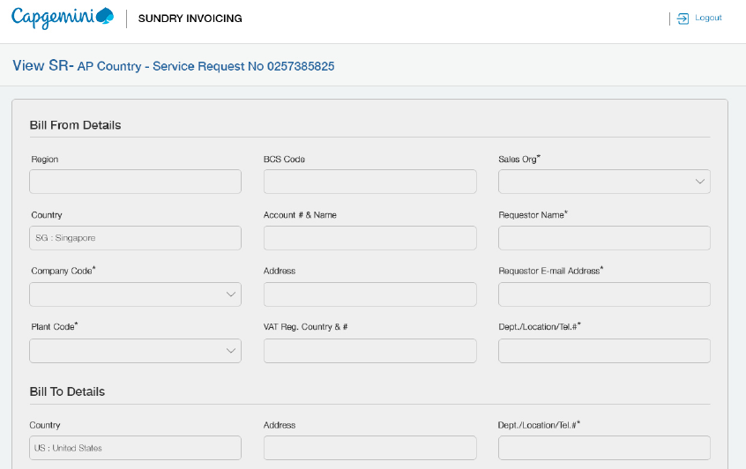
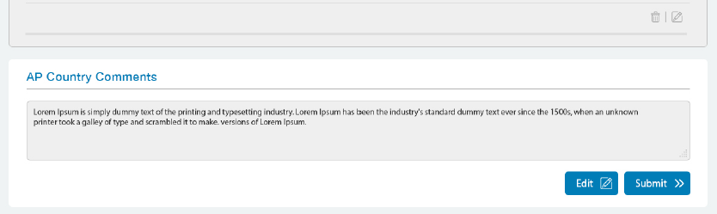
Fast Invoicing Screenshots: Flow of prototype
SR comments to be added

Slide 56
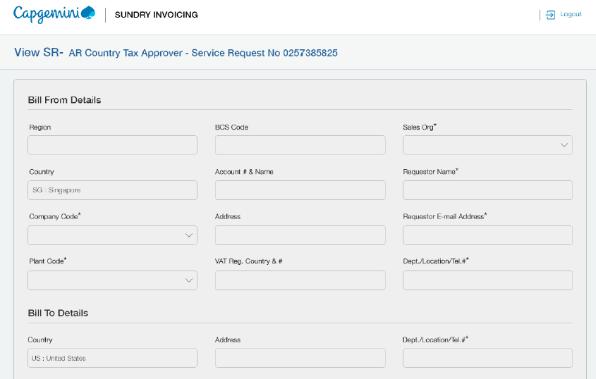
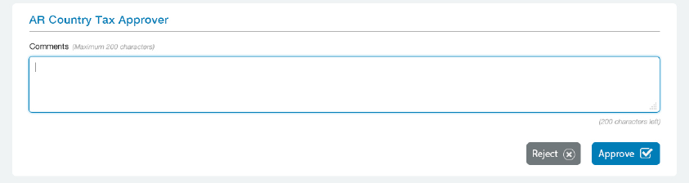
Fast Invoicing Screenshots: Flow of prototype
Tax approver page

Slide 57
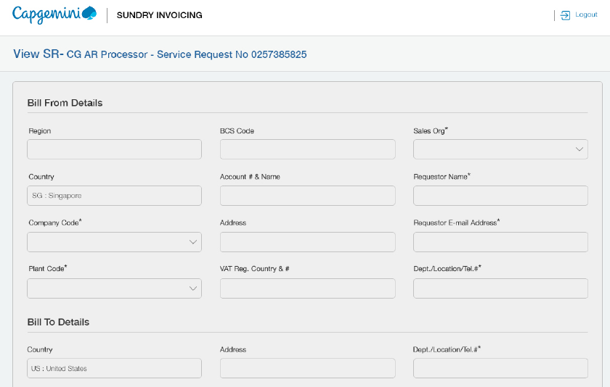
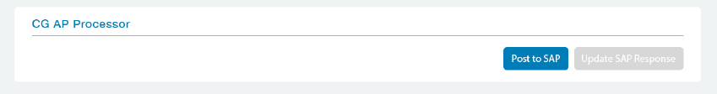
Fast Invoicing Screenshots: Flow of prototype
SR agent page

